Slide 1
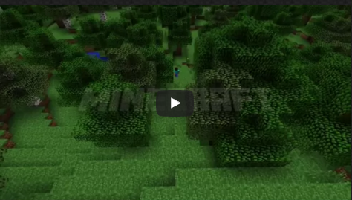
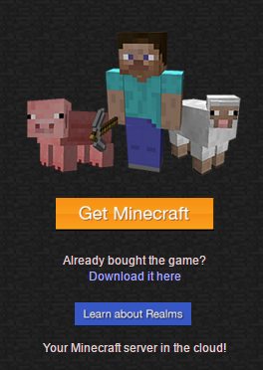
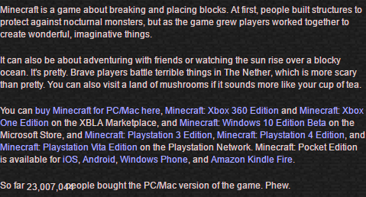
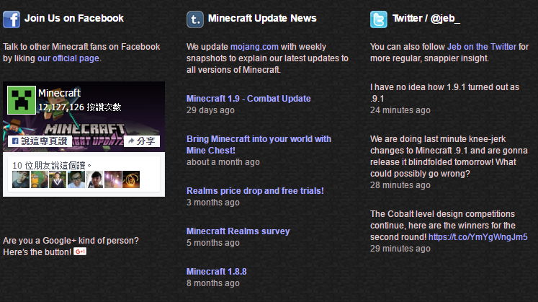

Slide 2
Home
Game
Community
Store
Profile
Help
Log In
Register
Get Minecraft
Learn
Title
Title
Title
Content
Content
Content
Content
Copyright©2016

